Slide 1
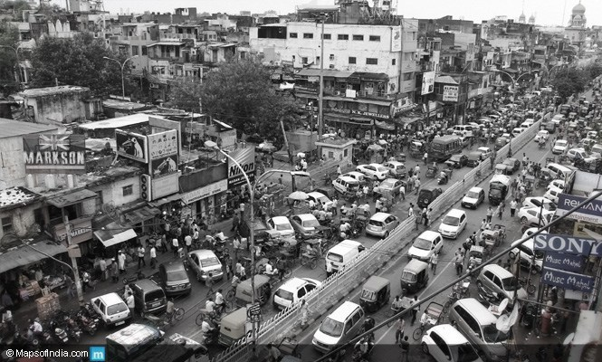
Traffic Congestion
Team : Sherl_Devs
Mihit Raj Keshav
Harshit Pathak
Sumit Bhattacharya

Slide 2
Vision
Main vision is not only to tackle traffic congestion but to do so in the most efficient way.
Our vision is divided into 3 spheres (might be a bit overlapping):
~ Tackling traffic congestion s due to Accidents
~ Checking on Illegal(or may be unneccesary) constructions
~ Eyeing on Road jamming due to vendors.

Slide 3
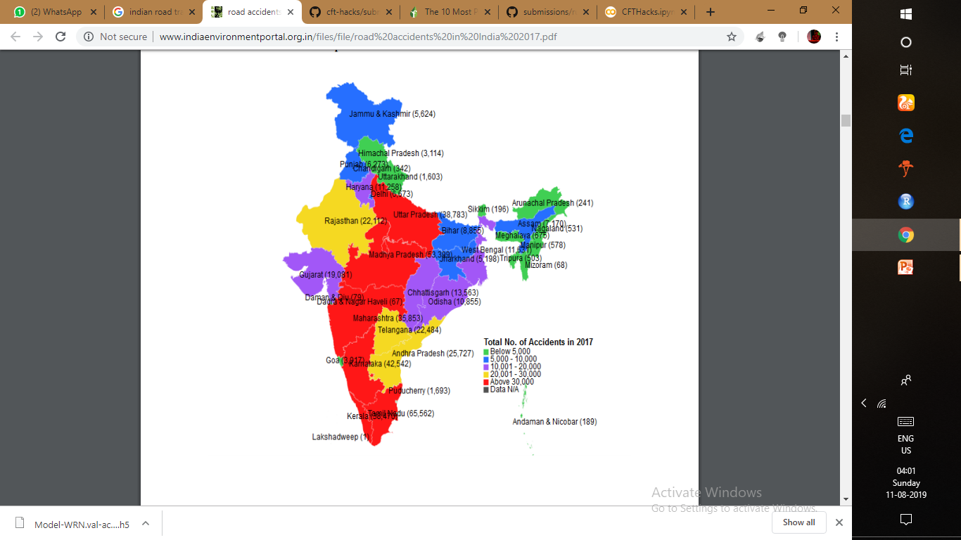
Sample Data of Road Accidents in India

Slide 4
Occurrence of Accidents
Judge severity of mishap using Machine Learning
Inform “Concerned Authority” accordingly
Introduction of Dual Rating Scheme and Incentive Scheme that will instil competition beneficial for the product.
Sending Image and/or Reviews regarding the accidents through the app
This is the main concept behind the 1st sphere of our product

Slide 5
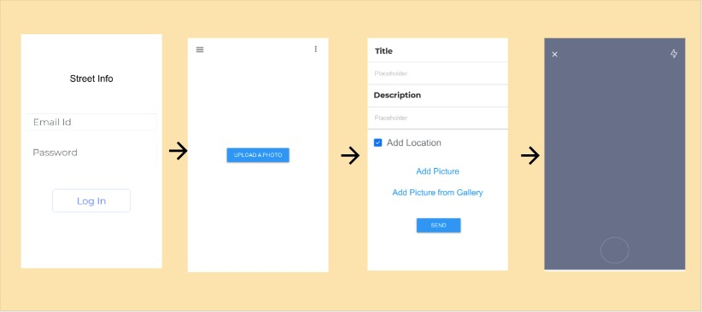
Snapshots of the prototype of the App
Screen for image Capture

Slide 6
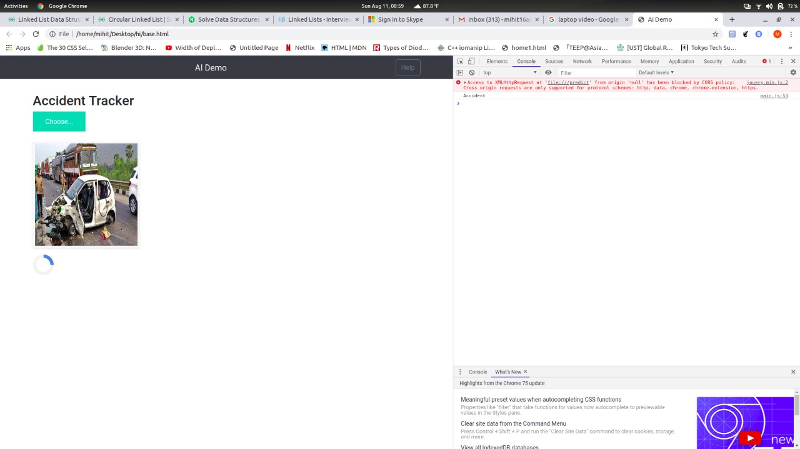
A prototype of how the server will work

Slide 7
The main idea behind the accident accounting feature is to manage it most efficiently so as to minimize congestion.
(‘Google Maps’ yet does not have the Live Accident Track-Update Feature).
The Vehicle To Infrastructure (V2I) technology will be used in lieu with the App to provide a better check on unnecessary congestions. Daily Pedal Commuters data along with the data of Transport will be fed into the server. An efficient management of “Congestion Pricing “ may be implemented in India.
This feature will make use of Web Cams installed at specified intervals on roads.

Slide 8
Market Research
Most of the features included in our App like Live Location tracking , Cab tracking, Speed-Distance tracking, have been implemented by Google along with its subtuaries like ‘Waze’.
Google Maps provide us very good results. But what our product is to GoogleMaps is equivalent to what Flipkart is to Amazon.
What’s new in our product (which has not been brought into commercial use atleast in India) is the Live Accident Update feature with Dual Rating and Incentive Schemes for Hospitals and Users.
Even the use of V2I Technology in the app will is new technique that will benefit the users as well as the administration.

Slide 9
Revenue Model
There are 2 phases of our model.
Business Model
1st Phase
Pitching Companies to advertise themselves through our App.
2nd Phase
Targeting Insurance companies
Decentralized Revenue Model

Slide 10
The basic concept of the model will be to form a Decentralized Network Market base for the App.
Any person who Logs into the App will be given 20 credits that can be redeemed directly from the bank. This will act as an incentive for them to share the App among more people, thus creating a network.
The 1st phase will revolve around Ad-Based Revenue generation which , in our opinion, will be fostered by the network created by the share-holders.
The 2nd phase will revolve around specific targets ( Ad-based system still continuing). The 1st target ought to be insurance companies whose insurance will be opted for by the vehicles owners. The fake insurance claims can be checked using the Real Time Accident feature of the product. The overall profit will be shared by the share-holders correspondingly.

Slide 11
Thank You

